Slide 1
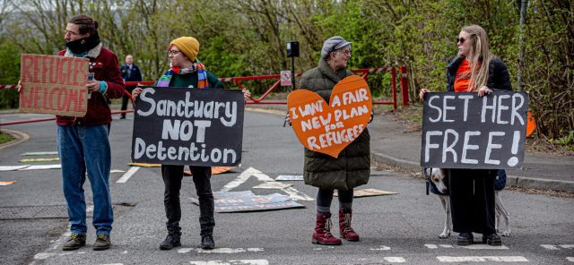
"It's like a prison, but we're not criminals"
Negotiating criminal justice within the anti-detention movement

Slide 2
Context
Around 20,000 people a year are detained under immigration powers
Increasing proportion of those in immigration detention are coming from having served a criminal sentence
Increasing criminalisation of migration (“crimmigration”) and increasing encroachment of border regime into criminal justice system
The anti-detention movement focuses on detention of asylum seekers and refugees
One dominant frame in detention communications is that “we are treated like criminals, but we haven’t committed a crime”
Education around detention focuses on critical distinctions between “immigration prisons with no judicial oversight” and “criminal prisons”
Relies on the idea that there are legitimate and just forms of imprisonment (criminal imprisonment) and non-legitimate forms (immigration detention), undermining criticisms of the racism of the criminal justice system and wider abolitionist demands
Paradox is that both groups are experiencing the impacts of the same immigration system and racialised border control

Slide 3
Research questions
Research questions:
How do activist groups organising against detention and deportation understand the relationship between criminal justice and migrant justice?
What affects and impacts framing decisions and campaign asks?
What possibilities are there for solidarity between detention abolition and prison abolition groups and campaigns
Hypotheses:
Groups increasingly respond to frames from political parties taking a “mythbusting” approach
Large NGOs with narrow and pragmatic campaign goals have a disproportionate influence framing decisions of smaller groups
Decisions are driven by a “respectability politics” and don’t reflect the diversity of opinions in the movement

Slide 4
Conceptual framework
Crimmigration
Stumpf (2006): increasing intertwinement of crime control and immigration control
Respectability Politics
Higginbotham (1994): Respectability is a strategy “used by marginalised social movements with the intention of gaining greater social acceptance from the broader population
Framing theory
Schwartz (1992): Universals structures of values

Slide 5
Methodological approach
Rooted in Critical Participatory Action Research (e.g Fine & Torre)
Research focussed explicitly on social transformation - cycles of action and reflection, drawing on traditions of Lewin, Freire
Interested in disturbing the subject-object power relation of traditional research to democratise knowledge production
Critical of some of the limitations of PAR
Challenges co-option of “participation” for neoliberal development programmes
Feminist PAR
encouraging dissent, exploring silences, multiple positionalities (Zeller-Berkman)

Slide 6
Methods
Peer interviews between activist group co-ordinators and staff and/or volunteers involved in communication and education work
Community archiving workshops bringing together members of different groups to look at frames being used in recent and more historic campaign communications around immigration detention
Basic quantitative text analysis using historic and current press releases

